Slide 1
RMI
Java makes RMI (Remote Method Invocation)
To send a message to a remote server object,
The client object has to find the object
Do this by looking it up in a registry
The client object then has to marshal the parameters (prepare them for transmission)
The server object has to unmarshal its parameters, do its computation, and marshal its response
The client object has to unmarshal the response

Slide 2
RMI NOTATION
A remote object is an object on another computer
The client object is the object making the request (sending a message to the other object)
The server object is the object receiving the request
The rmi registry is a special server that looks up objects by name
rmic is a special compiler for creating stub (client) and skeleton (server) classes

Slide 3
Processes
For RMI, you need to be running three processes
The Client
The Server
The Object Registry, rmiregistry, which is like a DNS service for objects

Slide 4
Remote interfaces and class
Must be public
Must implement the interface java.rmi.Remote or extend the class Remote
Every method in the interface must declare that it throws java.rmi.RemoteException (other exceptions may also be thrown)
Must implement a Remote interface
Should extend java.rmi.server.UnicastRemoteObject
May have locally accessible methods that are not in its Remote interface

Slide 5
The DNS is…
The Domain Name System
The Domain Name System distributes the responsibility for assigning domain names and mapping them to IP networks
The mechanism by which Internet software translates names to attributes such as addresses

Slide 6
The operations at the server
The operations at the server
Creating a file
Add host
Remove host
Lookup host

Slide 7
Creating a file(DNS server)
dird = new File("E:/temp/");
if (!dird.exists()) {
dird.mkdir();
}
nameList = new File("E:/temp/NameList.txt");
if (!nameList.exists()) {
try {
nameList.createNewFile();
} catch (IOException e)

Slide 8
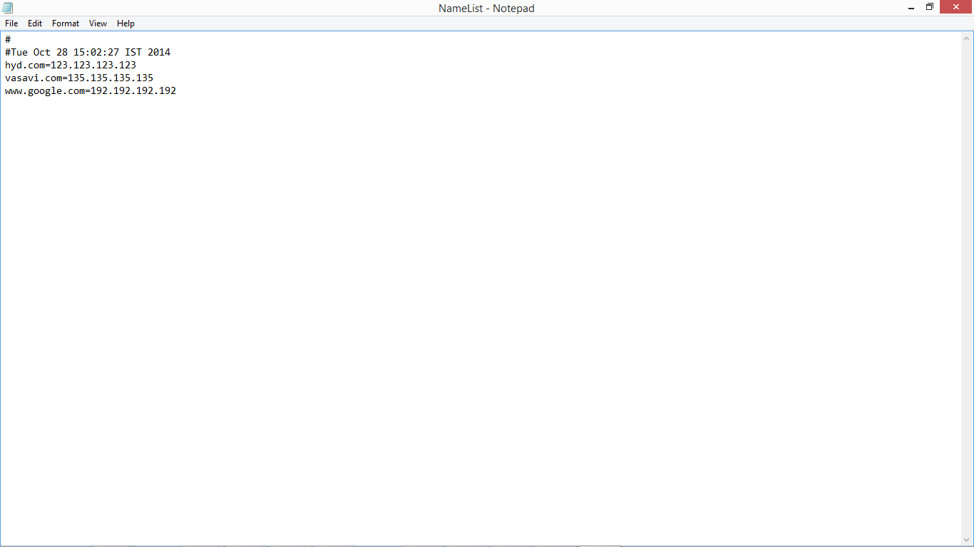
The file looks like this

Slide 9
Addhost()
if (hostRecords.get(hostName) != null) {
return false;
}
hostRecords.put(hostName, hostIP);
try {
fout = new FileOutputStream(nameList);
hostRecords.store(fout, "");

Slide 10
Remove host
try {
fin = new FileInputStream(nameList);
hostRecords.load(fin);
ip = (String) hostRecords.remove(hostName);
try {
fout = new FileOutputStream(nameList);
hostRecords.store(fout, "");
fout.close();
} catch (IOException ex) {
ex.printStackTrace();

Slide 11
lookuphost()
try
{
fin = new FileInputStream(nameList);
hostRecords.load(fin);
ip = (String) hostRecords.get(hostName);
fin.close();
}
catch (IOException ex) {
ex.printStackTrace();
}
return ip;

Slide 12
The operations at client

Slide 13
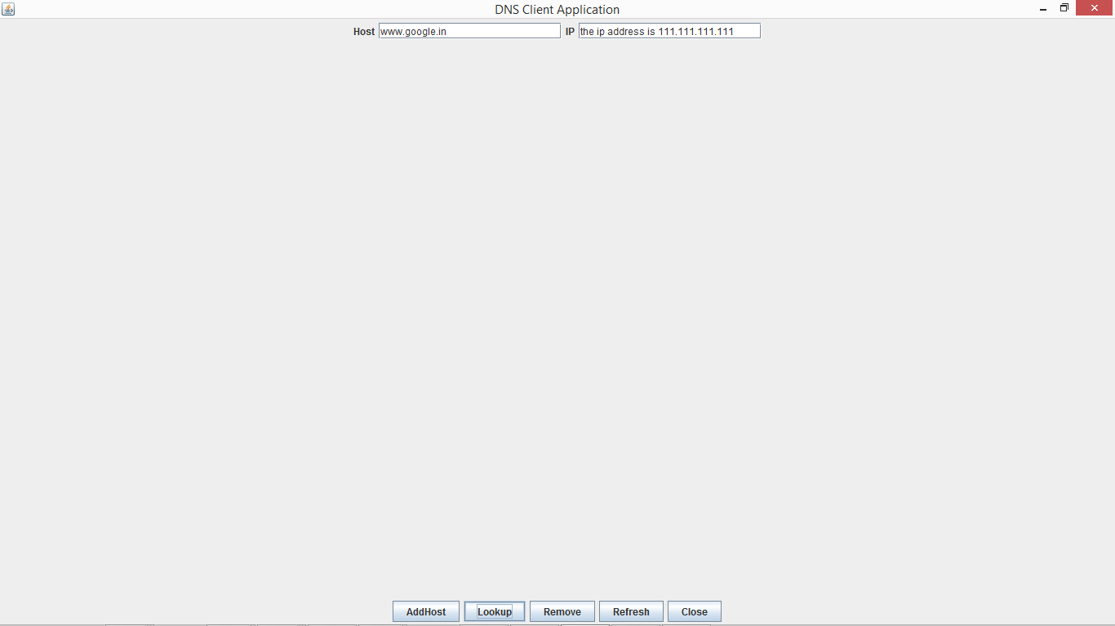
Lookup host
Its is used to lookup the host ip address
And return the ip address
try
{
fin = new FileInputStream(nameList);
hostRecords.load(fin);
ip = (String) hostRecords.get(hostName);
fin.close();
}
catch (IOException ex) {
ex.printStackTrace();
}
return ip;

Slide 14
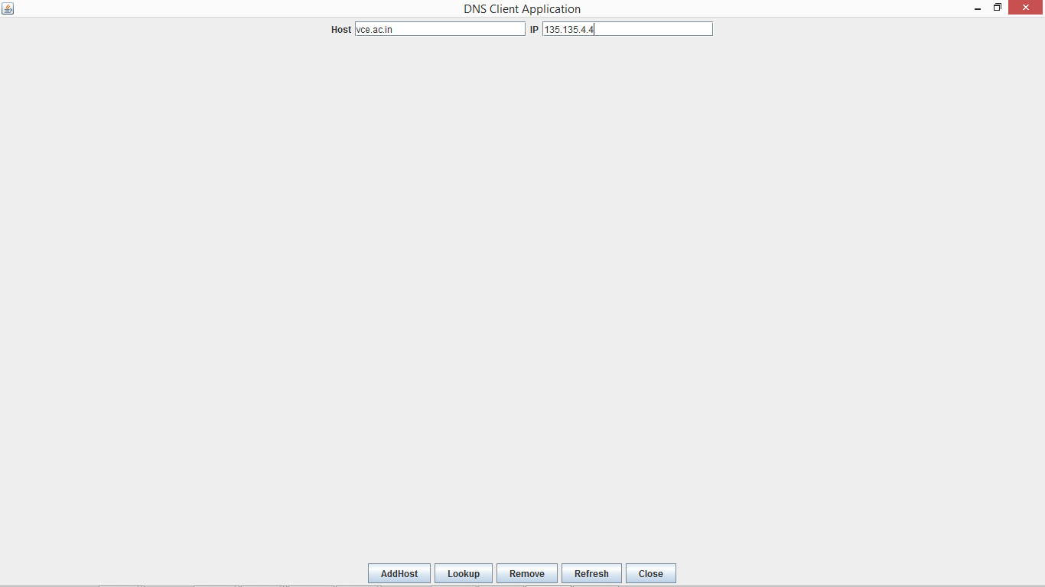
Add host
Its collects data from the text fileds and calls the addhost()
At the server
if (s.equals("AddHost")) {
if (!t1.getText().trim().isEmpty()
&& !t2.getText().trim().isEmpty()) {
Boolean b = dri.addHost(t1.getText(), t2.getText());
if (b == true) {
t2.setText("Registered");
} else {
t2.setText("Not Registered");
}

Slide 15
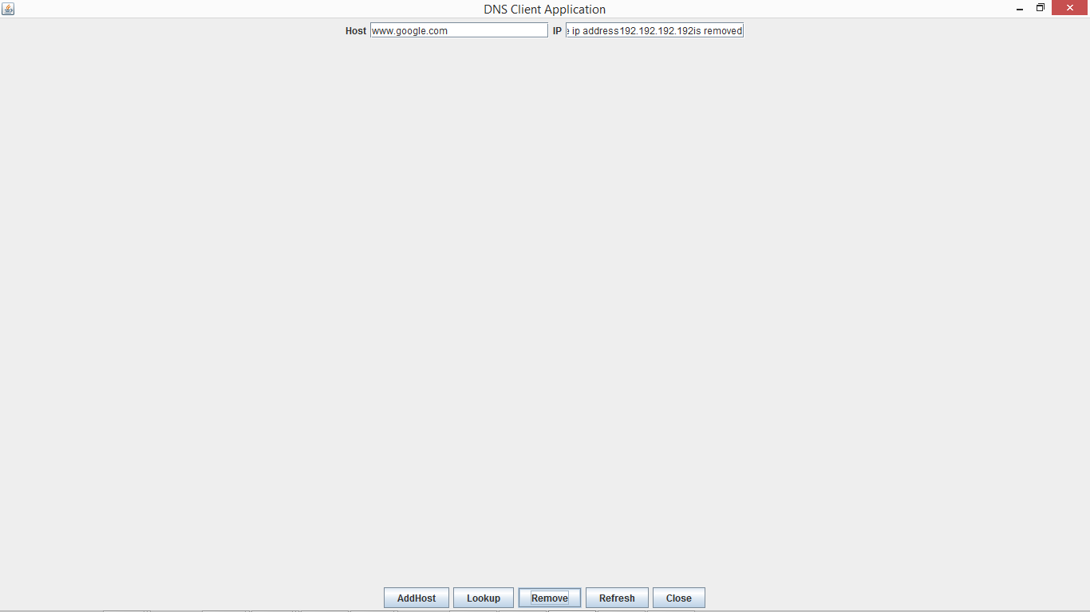
Remove host
When you press remove host it collects the
data from the host text filed and calls
removehost() fun in the server
If the names exits it removes
if (!t1.getText().trim().isEmpty()) {
String s2 = dri.removeHost(t1.getText());
if (s2 == null) {
t2.setText("host name not found");
} else {
t2.setText("the ip address" + s2 + "is removed");
}

Slide 16
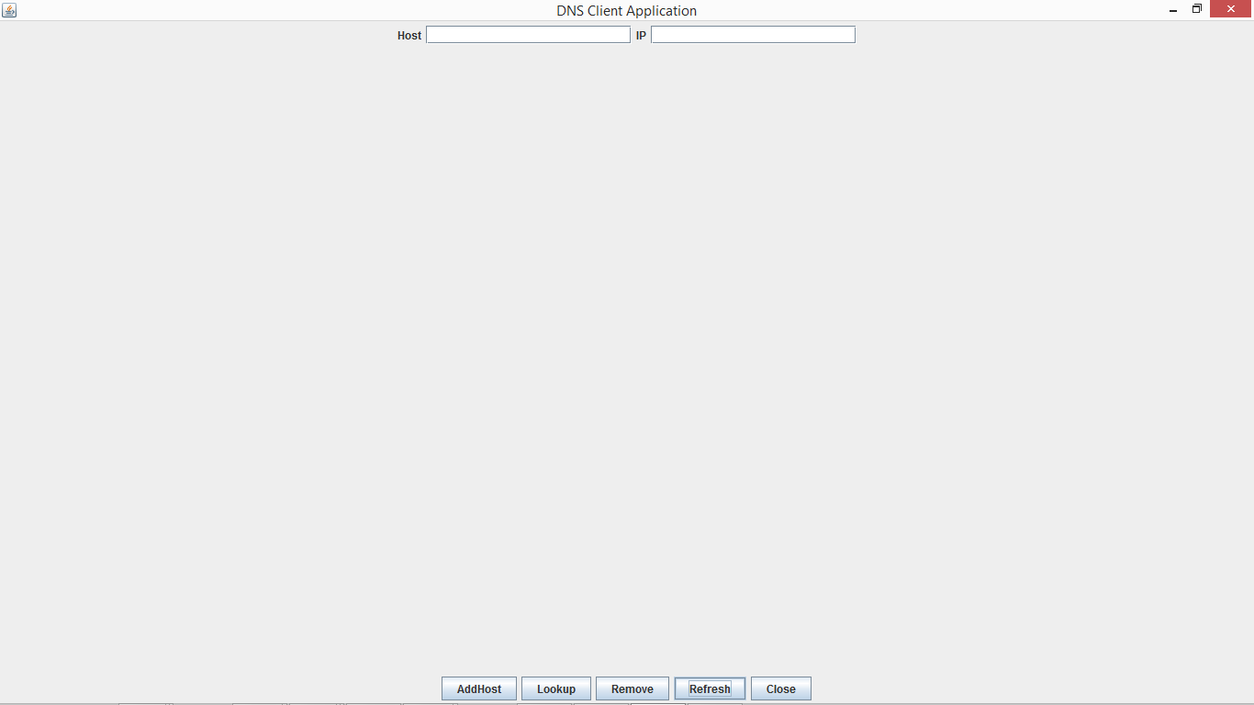
Clear and exit
When you press exit the applet closes and when
You press clear the fields become empty
if (s.equals("Refresh")) {
t1.setText("");
t2.setText("");
}
if (s.equals("Close")) {
System.exit(0);
}

